Slide 1
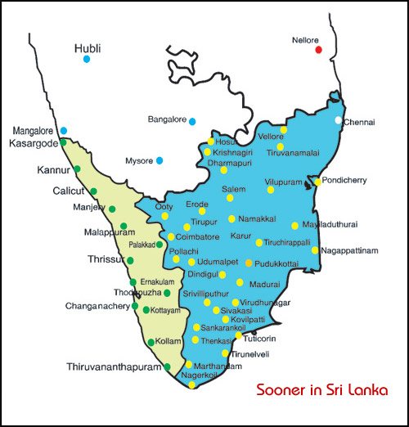
The Battle of South Indian States – Tamil Nadu and Kerala
Applied Data Science Capstone by IBM/Coursera

Slide 2
Contents
Introduction
Tamil Nadu
Kerala
Data
Districts in Tamil Nadu and Kerala
Clustering of the Districts
Insights
Conclusion
Future Scope
Analysis on the Area
Analysis of the Literacy Percentage
Analysis of the Population
Methodology
Cluster 1
Cluster 2
Cluster 3

Slide 3
Introduction
India’s two southern most states –
Tamil Nadu and Kerala
Explore, segment, and cluster to find :
the similarities between the states
the dissimilarities between the states
classify the various districts

Slide 4

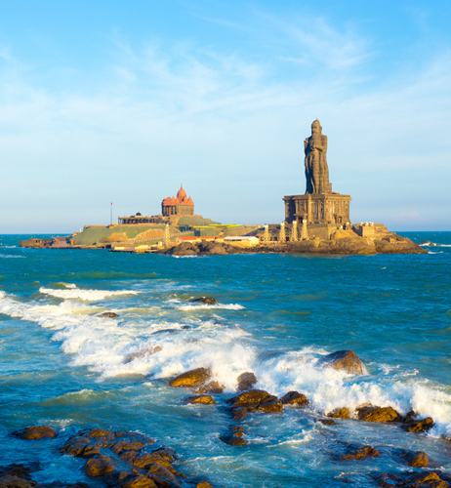
Tamil Nadu
Formerly Madras State
Capital City is Chennai
Spread over 118,119 km²
Bordered by the union territory of Puducherry and the South Indian states of Kerala, Karnataka, and Andhra Pradesh
Notes:
Consider talking about:
Origins
Middle Ages to Louis XIV
18th and 19th centuries
20th and 21st centuries

Slide 5
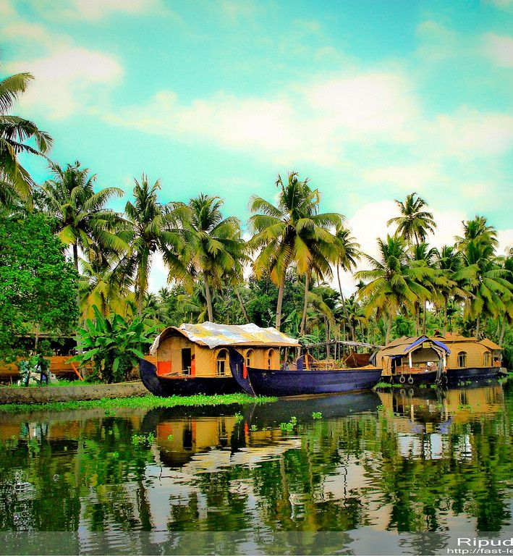
Kerala
On the southwestern Malabar Coast of India
Capital City is Thiruvananthapuram
Spread over 38,202 km²
Bordered by Karnataka to the north and northeast, Tamil Nadu to the east and south, and the Lakshadweep Sea to the west
Notes:
Consider talking about:
Climate

Slide 6
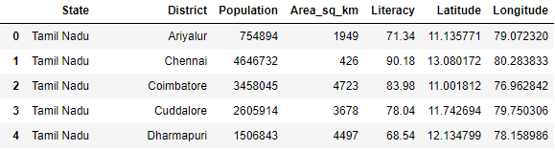
Data
Final Dataset
Tamil Nadu Districts Wikipedia Data
Tamil Nadu Districts Census 2011 Data
Kerala Districts Wikipedia Data
Kerala Districts Census 2011 Data
Geocoder – for latitude and longitude
Foursquare API – for the top venues

Slide 7
Methodology
Business Problem
Battle of two Southern Indian States – Tamil Nadu and Kerala
Data Collection
Wikipedia
Data Cleaning
Kept only the required metrics
Census 2011
Geocoder
Foursquare API
Transformed the data into right data type in Python
Exploratory Data Analysis
Using python explore the data
Generate bar graphs
Conclusion
Discussion
Insights
Report
Visualize the data on the map
Clustering and Segmenting
Notes:
Consider talking about:
Transport
Electricity
Water and sanitation
Parks and gardens
Cemeteries

Slide 8
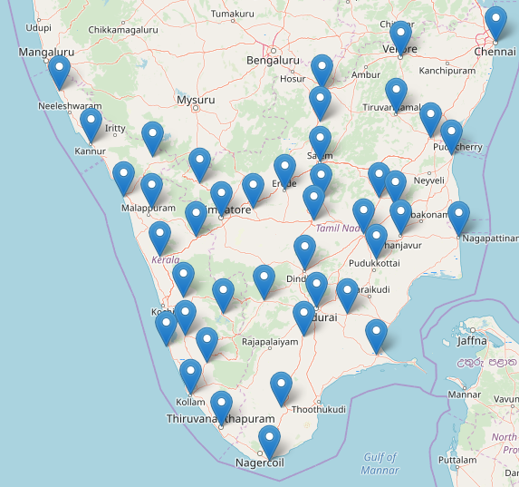
Districts in Tamil Nadu and Kerala
Total 42 districts in both the states
Tamil Nadu – 28 Districts
Kerala – 14 Districts
Notes:
Consider talking about:
Migration
Religion

Slide 9
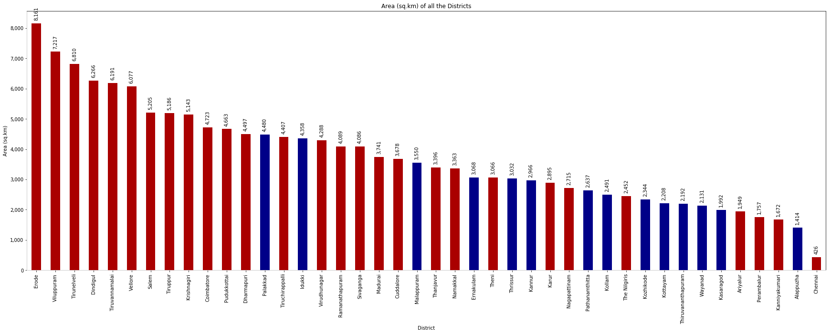
Analysis on the Area
Area of Tamil Nadu > Area of Kerala
Tamil Nadu – 118,119 km²
Kerala – 38,202km²
Tamil Nadu
Smallest District - Chennai
Largest district – Erode
Kerala
Smallest District - Alappuzha
Largest district – Palakkad
Notes:
Consider talking about:
City government
Métropole du Grand Paris
Regional government
National government
Police force

Slide 10
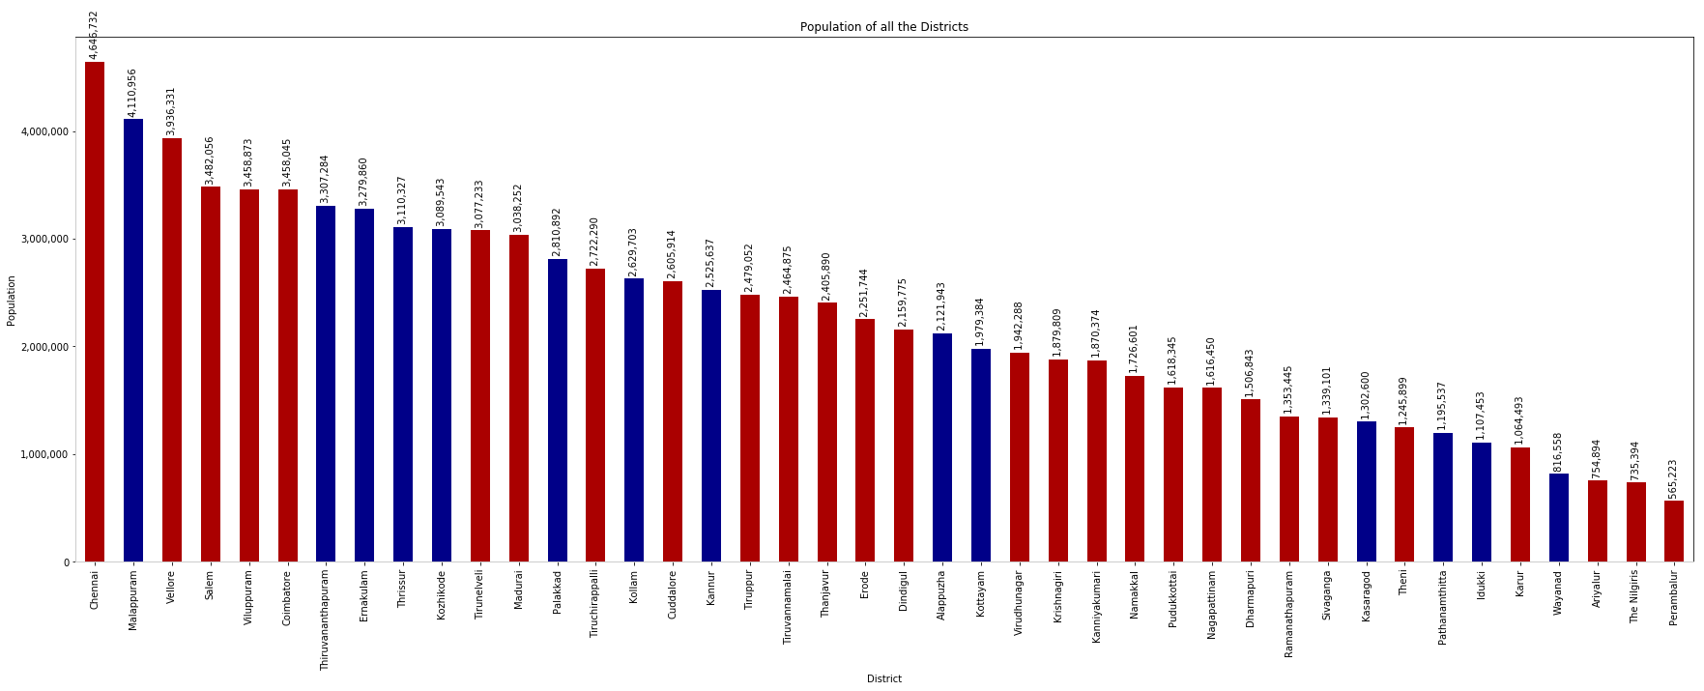
Analysis of the Population
Population of Tamil Nadu > Population of Kerala
Tamil Nadu – 61.41M
Kerala – 33.39M
Tamil Nadu
Least Populated district - Parambalur
Most Populated district – Chennai
Kerala
Least Populated district - Wayanad
Most Populated district – Malappuram
Notes:
Consider talking about:
City government
Métropole du Grand Paris
Regional government
National government
Police force

Slide 11
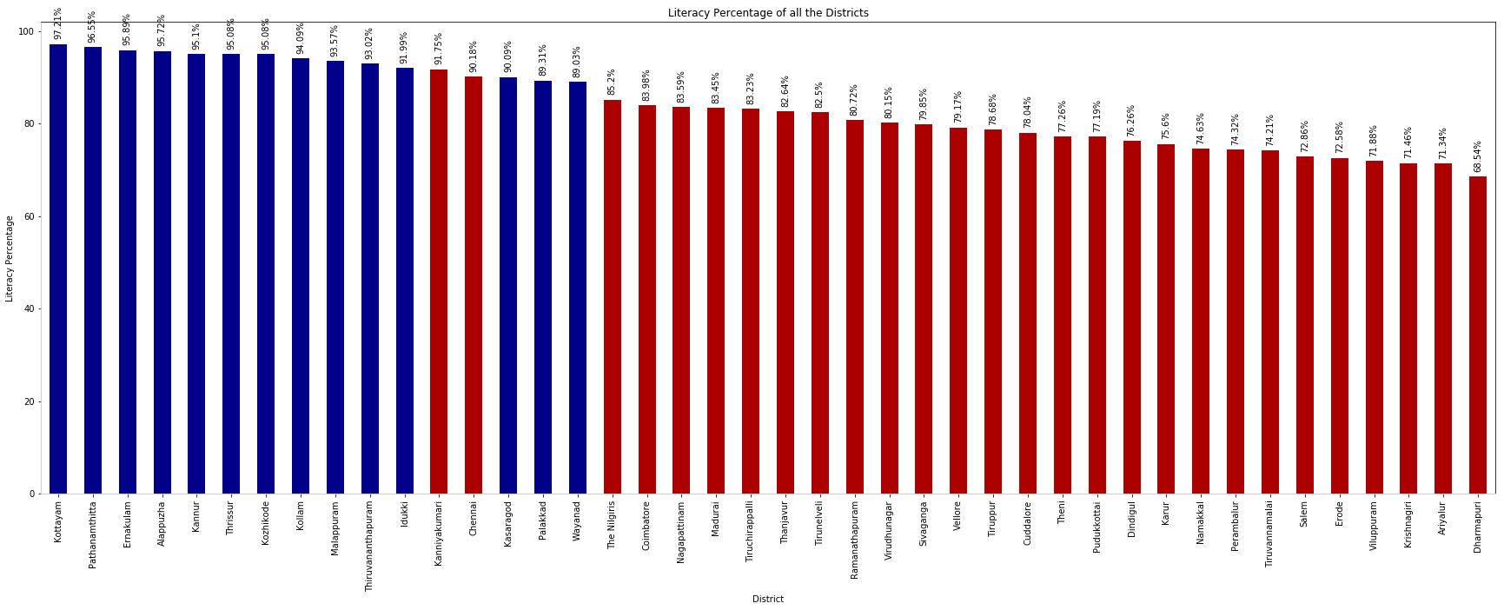
Analysis of the Literacy Percentage
Literacy Percentage of Kerala > Literacy Percentage of Tamil Nadu
Kerala – 94%
Tamil Nadu – 80%
Tamil Nadu
Least Literate district - Dharmapuri
Most Literate district – Kanyakumari
Kerala
Least Literate district - Wayanad
Most Literate district – Kottayam
Notes:
Consider talking about:
City government
Métropole du Grand Paris
Regional government
National government
Police force

Slide 12
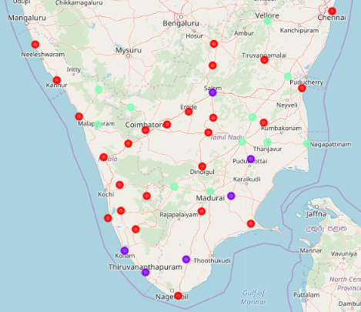
Clustering of the Districts
Both the states are really good for residential as well as tourism.
Top most common venues in these districts
Indian Restaurant
Hotel
Resort
Notes:
Consider talking about:
Monuments and attractions
Hotels

Slide 13
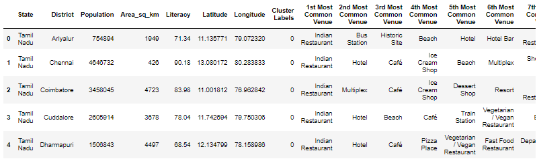
Cluster 1 - Tourism and Metropolitan Districts
Tamil Nadu: Ariyalur, Chennai, Coimbatore, Cuddalore, Dharmapuri, Dindigul, Erode. Kanyakumari, Karur, Krishnagiri, Namakkal, Ramanathapuram, Tiruppur, Tiruvannamalai, and Virudhunagar
Kerala: Alappuzha, Ernakulam, Idukki, Kannur, Kasaragod, Kottayam, Kozhikode, Palakkad, Pathanamthitta, and Thrissur

Slide 14
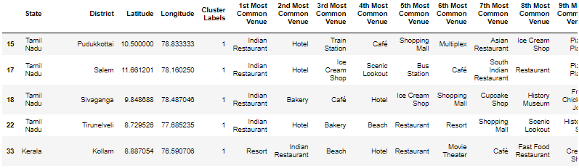
Cluster 2 - Mix of Tourism and Residential Districts
Tamil Nadu: Pudukkottai, Salem, Sivaganga and Tirunelveli
Kerala: Kollam and Thiruvananthapuram

Slide 15
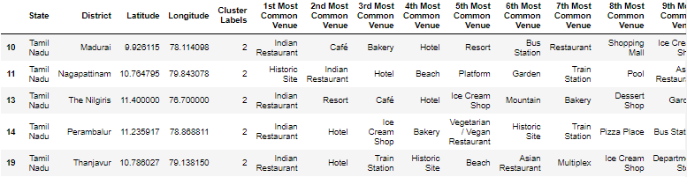
Cluster 3 - Residential and Urban Districts
Tamil Nadu: Madurai, Nagapattinam, The Nilgiris, Perambalur, Thanjavur, Theni, Tiruchirappalli, Vellore, and Viluppuram
Kerala: Malappuram and Wayanad

Slide 16
Insights
Both the states are really good for residential and tourism purposes
Good Food – The most common venue in both the states is Indian Restaurants, in general there are a lot of restaurants.
Literacy Percentage
Even though Tamil Nadu larger in size and population when compared Kerala, the number of literate people in Kerala is more.
Chennai – Capital of Tamil Nadu
Smallest district - has the least area among all the districts with 426 km²
Over populated – has the highest population among all the districts with 4.65M population
Notes:
Consider talking about:
Twin towns and partner cities
Other relationships

Slide 17
Conclusion
Successfully used the available resources for the comparison.
Both these southern states are quite similar, but, we can’t guarantee it based on the area, population, literacy percentage and common venues.
Since the radius limitation of Foursquare API is 100km, this analysis is not very accurate.
Notes:
Consider talking about:
Libraries

Slide 18
Future Scope
Need to look at various other points such as weather, employment rate, income, etc. – to come to a definite point.
If the restriction on the Foursquare API radius restriction gets removed, then this analysis can be performed again to get more clearer picture.
Notes:
Consider talking about:
Libraries

Slide 19
Thank You!
Notes:
Consider talking about:
Employment
Unemployment
Incomes

